Slide 1
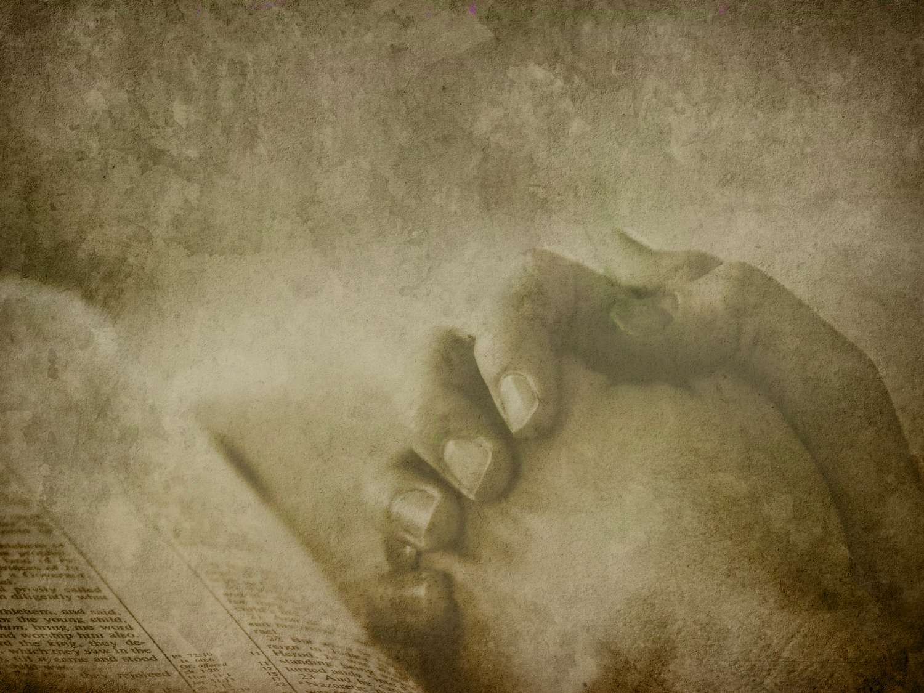
我以祷告来到祢跟前 Every time I pray

Slide 2
我以祷告来到祢跟前,
I will come to You in prayer 我要寻求祢.
I will seek Your face 我要站在破口之中,
I will stand within the gap 在那里我寻求祢.
There will I intercede
1/4

Slide 3
每一次我祷告, 我摇动祢的手,
For every time I pray, I move the hand of God 祷告做的事, 我的手不能做.
My prayer does the things,
my hands cannot do 每一次我祷告, 大山被挪移,
For every time I pray,
the mountains are removed 道路被铺平, 使列国归向祢.
The paths are made straight,
And nations turn to You.
2/2

Slide 4
2. 主我是软弱及无助,
I am weak and helpless Lord 祢却是我的力量.
You, my strength shall be 以祢亲切的手引导我,
Guide me with Your gracious hand
那就是我的得胜.
There will my victory be.
3/4

Slide 5
每一次我祷告, 我摇动祢的手,
For every time I pray, I move the hand of God 祷告做的事, 我的手不能做.
My prayer does the things,
my hands cannot do 每一次我祷告, 大山被挪移,
For every time I pray,
the mountains are removed 道路被铺平, 使列国归向祢.
The paths are made straight,
And nations turn to You.
4/4

Slide 6
每一次我祷告, 我摇动祢的手,
For every time I pray, I move the hand of God 祷告做的事, 我的手不能做.
My prayer does the things,
my hands cannot do 每一次我祷告, 大山被挪移,
For every time I pray,
the mountains are removed 道路被铺平, 使列国归向祢.
The paths are made straight,
And nations turn to You.
4/4

